Slide 1
Systems Analysis and Design CT026-3-1-SAAD
Week 1
Introduction and Module Overview

Slide 2
Lecturer Information
Lecturer Name: Ms. Vasugi Jayamangalam
Email: vasugi.rajoo@apu.edu.my

Slide 3
Pre-Requisites For This Module
None

Slide 4
Outcomes Based Education
OBE is education based on producing particular educational outcomes that:
Focus on what students can actually do after they are taught.
Expect all learners / students to successfully achieve particular (sometimes minimum) level of knowledge and abilities.
It’s NOT what We want to teach.
It’s WHAT You should learn.

Slide 5
Aims of this module
In the process of software engineering, the increase in business process complexity has led to the need of a series of systematic processes through the use of Information System. Systems Analysis and Design explores on the System Development Life Cycle (SDLC) stages, the people involved and how the systems are tested and implemented. This module will focus on the analysis of case studies and development of solution design using wireframes and prototypes.

Slide 6
Module Learning Outcomes
CLO​ | Learning Outcomes​ | Assessment​
1​ | Explain the basic concepts of analysis and design in systems development. (C2, PLO1) | Class Test
2​ | ​Build a prototype using the stages of SDLC for a given case study. (C3, PLO2) | ​Assignment
3​ | ​Report by documenting the system analysis and solution design for the prototype. (A3, PLO5) | ​Assignment

Slide 7
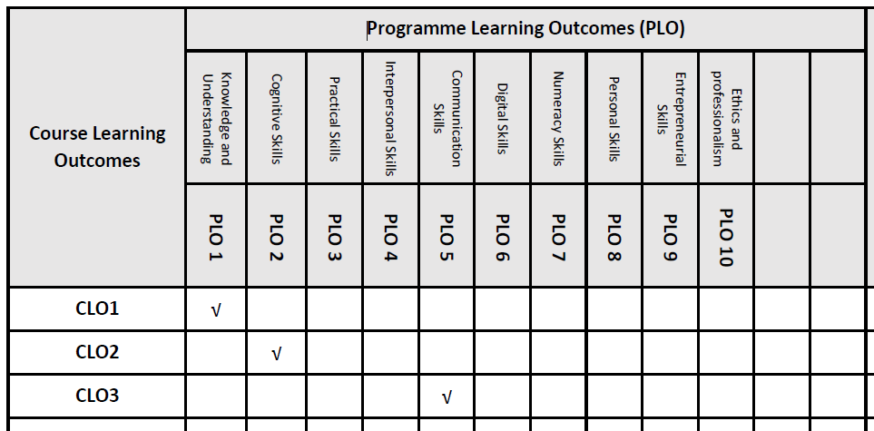
Mapping of CLO with PLO
The learning domains are:
PLO1: Knowledge and Understanding
PLO2: Cognitive Skills
PLO5: Communication Skills

Slide 8
Student Learning Time (SLT)
Module Credit Value: 3
Total Learning Hours:
Lecture | 2 hours per week
Tutorial | 1 hour per week
Independent Learning Time | 78 hours per semester
Total learning Hours | 134 Hours

Slide 9
Module Content Outline
Week | Topic
1 | Module Introduction
2 | Introduction to Information System-
3 | System Analyst and Project Manager-
4 | System Development Life Cycle (SDLC)
5 | Planning
6. 7. 8 | Analysis
8, 9 | Design
10 | Implementation
11 | Deployment and Maintenance
12-13 | Submission and Presentation
14 | Presentation and Class Test

Slide 10
Assessment Summary (refer to module handbook and module descriptor)
Form of Assessment | Assessment Methods | Hand Out Date | Hand In Date | %
Continuous Assessment | Assignment | Week 2 | Week 12 | 70%
Final Assessment | Class Test | Week 12-14 |  | 30%
Assessment requirement: Include any specific requirement to pass the module (refer to module handbook for the information), such as:
To pass the module, you must attempt every element of assessment and achieve at least 50% in the module overall.

Slide 11
Student Assessment Information Sheet
No. | Description | % of marks
1 | Group Assignment (Introduction 5%, Problems and solutions 5%, Project Planning 5%, Feasibility Study 10%, System Analysis 10%, Context Diagram 10%, Prototype Design 20%, Overall Documentation 5%, Requirement Gathering 5%, Design - DFD-0/1 & Data Dictionary 15%, Presentation 10%) | 100
2 | Class Test | 100
 | Total | 100

Slide 12
Expectations
Abide by ALL rules and regulations of APU.
Proper attire.
Attendance is compulsory. Valid Medical Certs must be supported in any absence from class.
Three cases of Late will be equal to 1 absence.
Use proper academic references – APA Referencing only.
Academic Dishonesty / Plagiarism is a serious offence. Any suspicions will be referred to the University’s Academic Dishonesty Board.
Formal assessments must be submitted on time in the specified format given. Failure to meet deadlines will be treated as non-submission and no marks will be awarded. Incomplete submissions will be subjected to penalty of mark deductions or forfeit.

Slide 13
Other Expectations
Mutual respect
Accountability
Participation in group-work / class-work

Slide 14
Achievement Requirements: Undergraduate (Diploma, Foundation, Degree)
Marks | Alphabetical Grade | Grading Point | Classification
80-100 | A+ | 4.0 | Distinction
75-79 | A | 3.7
70-74 | B+ | 3.3 | Credit
65-69 | B | 3.0
60-64 | C+ | 2.7 | Pass
55-59 | C | 2.3
50-54 | C- | 2.0
40-49 | D | 1.7 | Fail (marginal)
30-39 | F+ | 1.3 | Fail
20-29 | F | 1.0 | Fail
0-19 | F- | 0 | Fail

Slide 15
Reference Materials
Course Materials available in Moodle
Essential and Further Readings
Module handbook
Module descriptor
Lecture slides
Tutorial/Lab materials
Blokdyk, G. (2021). Systems Analysis and Design A Complete Guide - 2020 Edition. 5STARCooks. ISBN: 1867348993
Dennis, A., Wixom, B., Tegarden, D. (2020). Systems Analysis and Design: An Object-Oriented Approach with UML. 6th ed. Wiley. ISBN: 111955991X
Blokdyk, G. (2021). Systems Development Lifecycle A Complete Guide - 2020 Edition. 5STARCooks. ISBN: 9780655927563
*Further readings will be assigned from time to time.

Slide 16
Your Valuable Feedback
You are welcome to discuss your views on this module at any point of time.
Do fill in anonymous evaluation questionnaires in the student feedback form. There are two points - mid and end of the teaching semester.
The feedbacks you provide will be constructive for improvement of teaching and module content development.

